Slide 1

Future-Proofing Airport Parking at Ontario International Airport
Team 1 Consulting

Slide 2






Our team
Benjamin Tran
Team Lead
Elijah Chan
Machine Learning Specialist
Chelsey Luc
Data Strategist
Kellan Young
Data Analyst
Ella Lee
Marketing Strategist

Slide 3
01
02
03
04
Executive Overview
Data Visualizations
Recommendations
Implementation

Slide 4
01
Executive Overview

Slide 5
Current Standing
Strengths
➢ Expanding passenger demand post-pandemic
➢ Digital Infrastructure Upgrades(PARCS, GTMS)
Weaknesses
➢ Uneven Lot Utilization
➢ Customer Perception of Remote Lots
➢ Limited Hourly Parking
Opportunities
➢ Dynamic pricing expansion
➢ Pre-Booking Growth
➢ EV & Sustainability Initiatives
Threats
➢ Rideshare & Autonomous Trends
➢ Economic downturns in travel behavior
➢ Regional Competition

Slide 6
Problem Statement
Ontario International Airport (ONT) faces challenges in optimizing parking utilization and sustaining revenue as mobility trends reshape traveler behavior

Slide 7
Our Focus
Implement a real-time demand-based pricing model to mitigate uneven lot utilization
Enhance customer experience in response to evolving technology, vehicle, and travel trends
01
02

Slide 8
02
Data Visualizations
Uncovering the current trends in OIA popularity and parking lot utilization

Slide 9
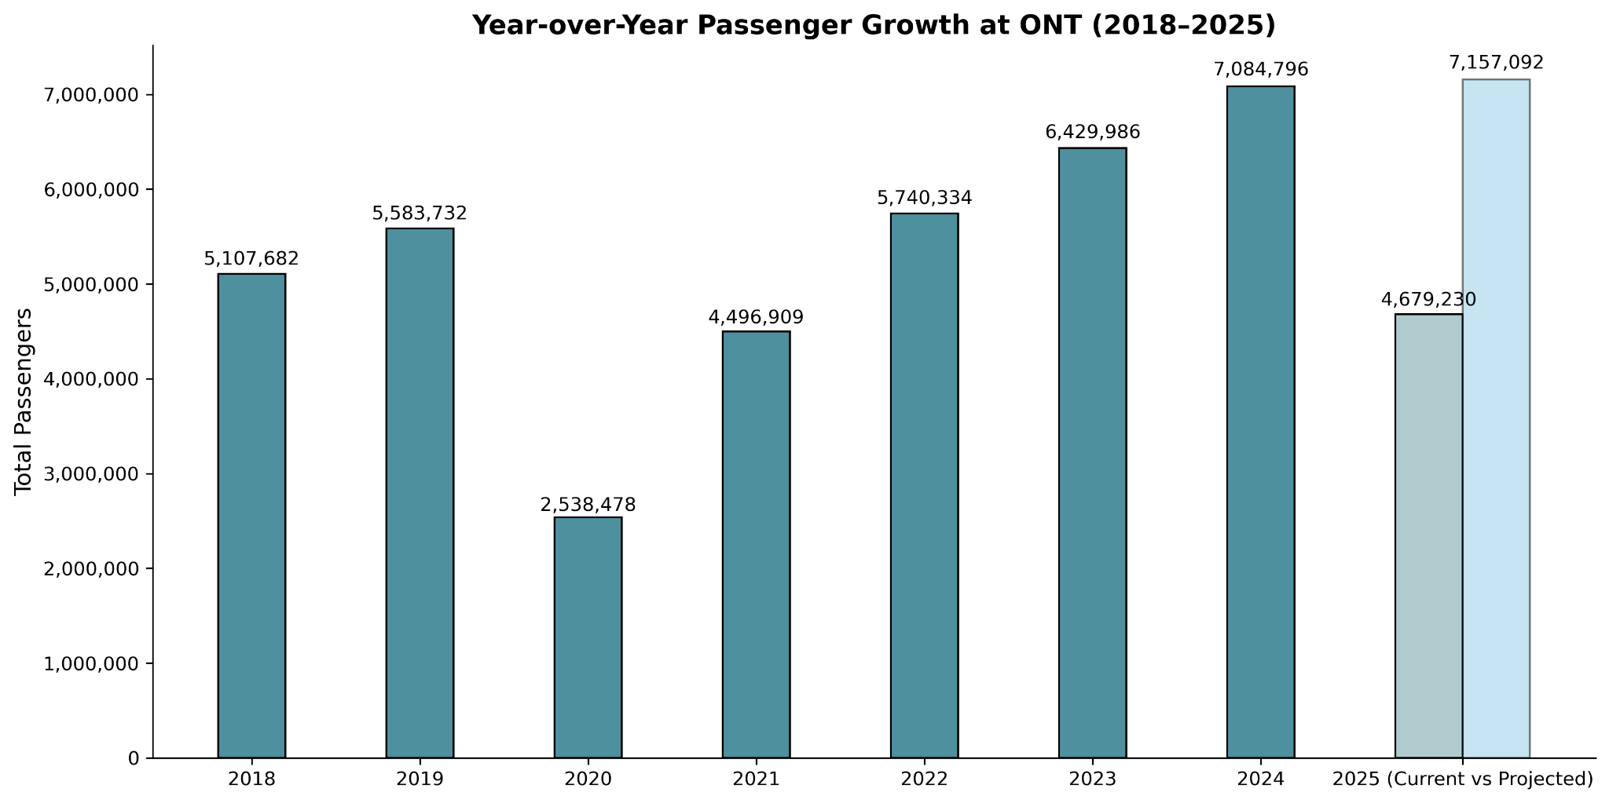
Passenger numbers declined during COVID, then steadily recovered, surpassing pre-pandemic levels after 2022, and are now projected to exceed 7 million for the second time this year.
Notes:
Dip during covid, steady recovery, exceeding before numbers after 2022
Projected over 7 million this year (made by comparing first 8 months of last year to first 8 months this year)

Slide 10
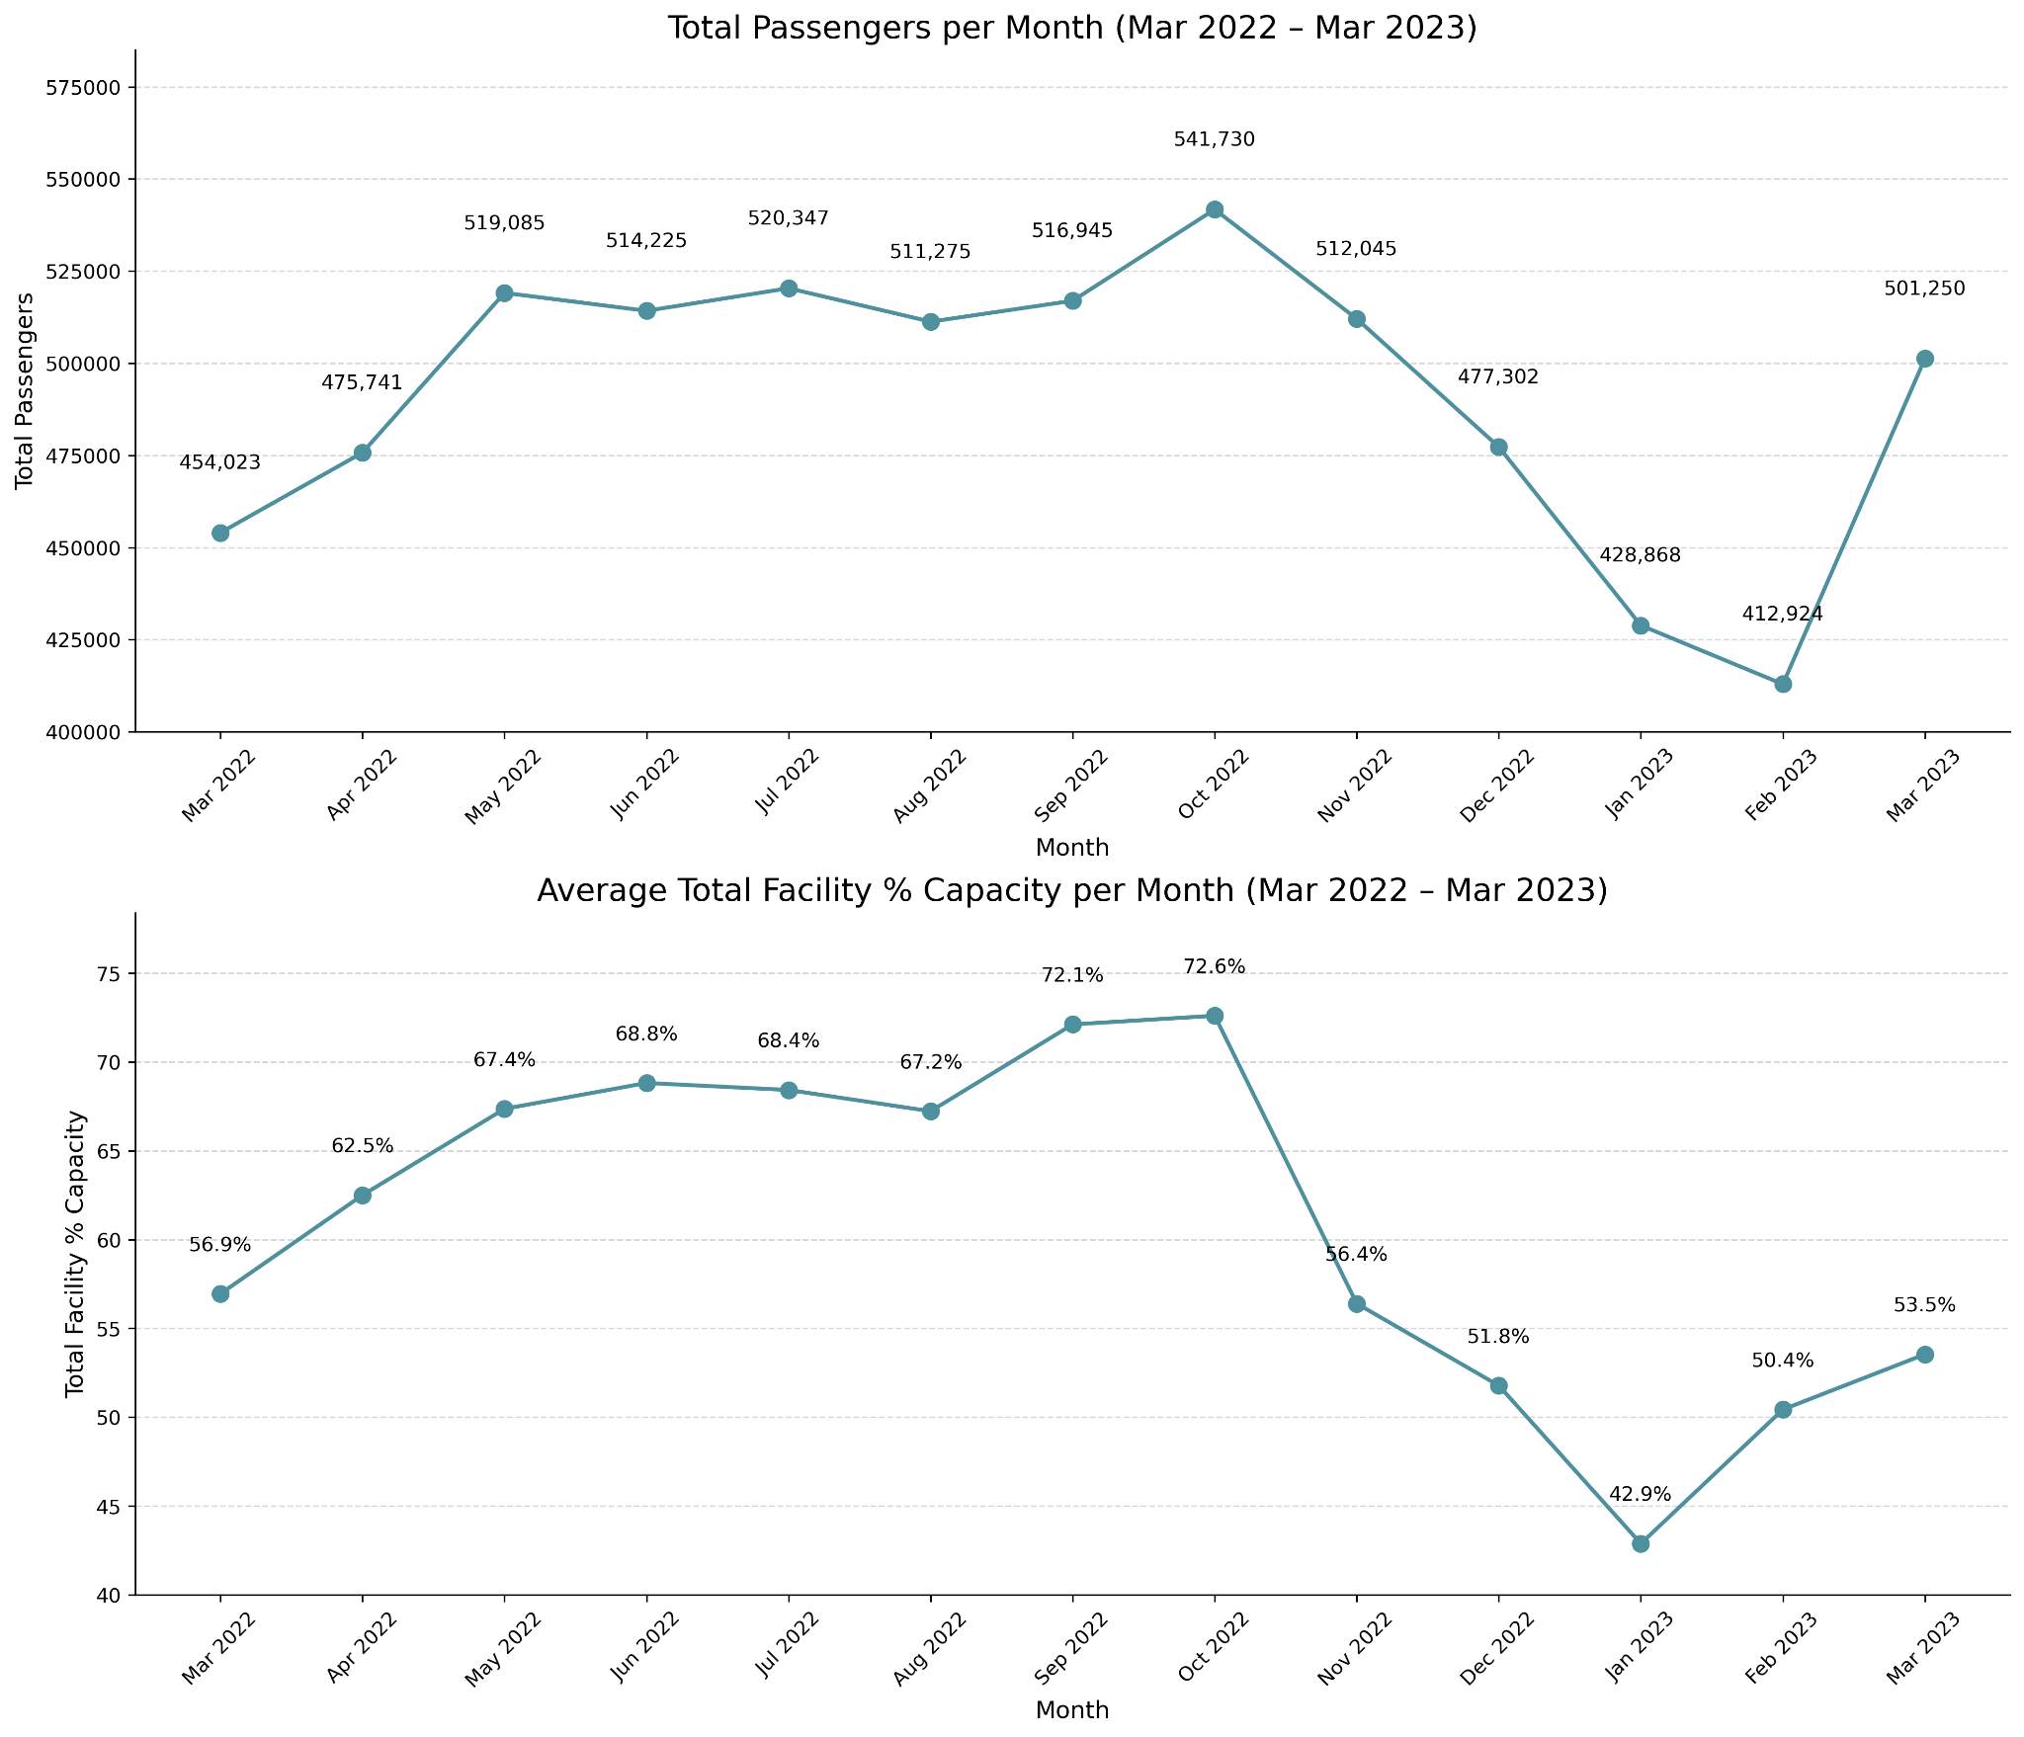
Passenger participation is relatively parallel with parking occupancy percentages
Notes:
Passenger participation is parallel with parking occupancy percentages
(march 2022-2023) as example

Slide 11
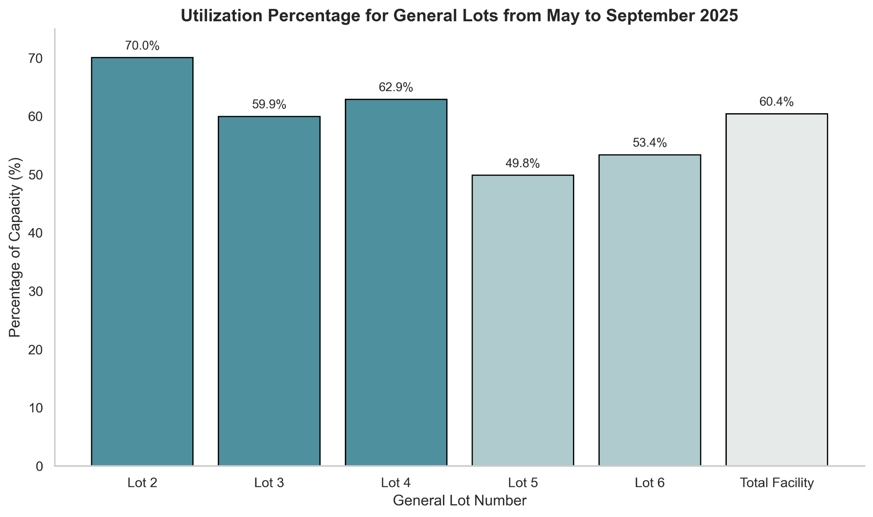
Lot 5 and 6 are currently underutilized in relation to other lots

Slide 12
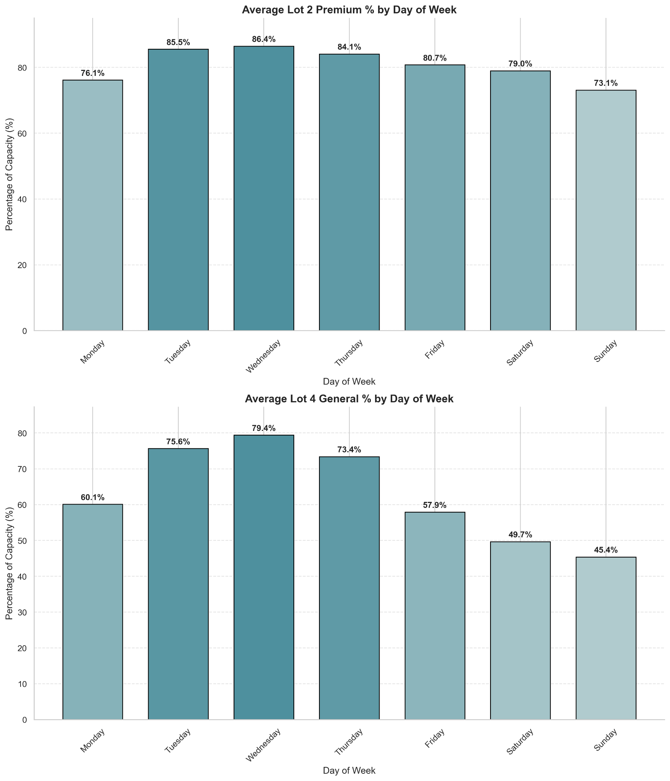
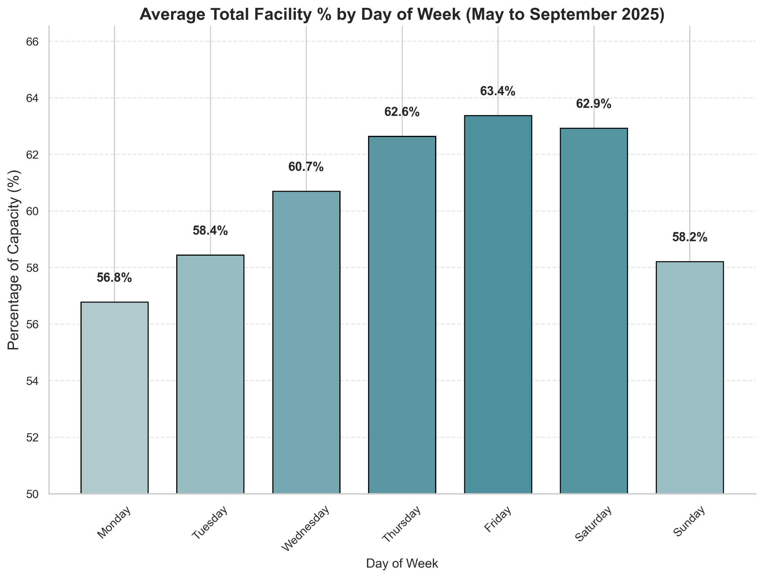
Over the past five months, parking distribution by day of the week is consistent across all lots increasing from Thursday to Saturday, except for Lot 2 Premium and Lot 4 General, where it increases from Tuesday to Thursday.

Slide 13
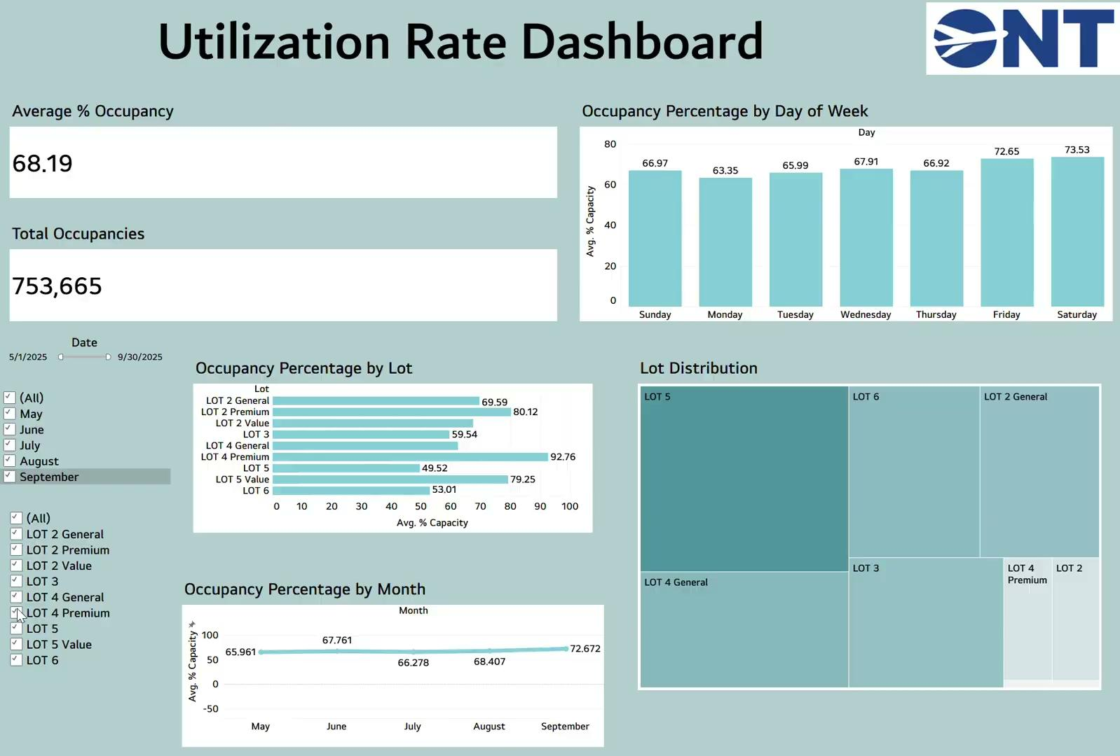

Slide 14
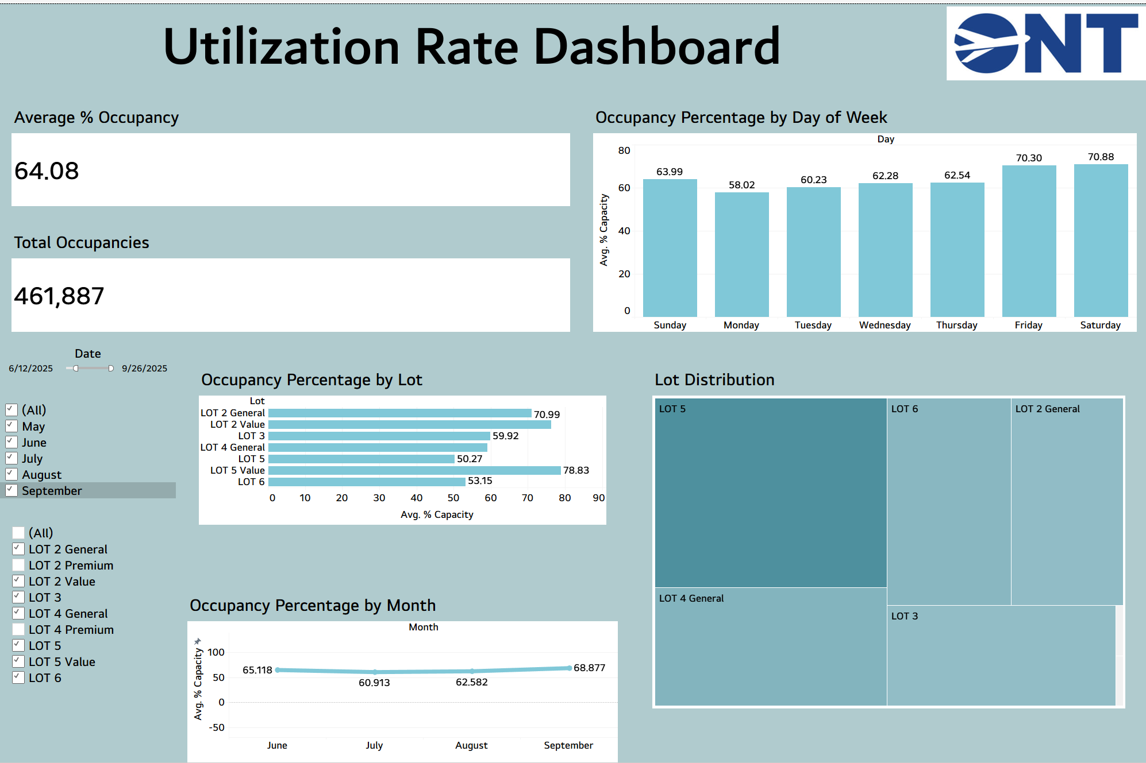

Slide 15
03
Recommendations

Slide 16
Utilization
Modernization
&
Adaptation
Customer experience

Slide 17
Utilization
Solutions

Slide 18
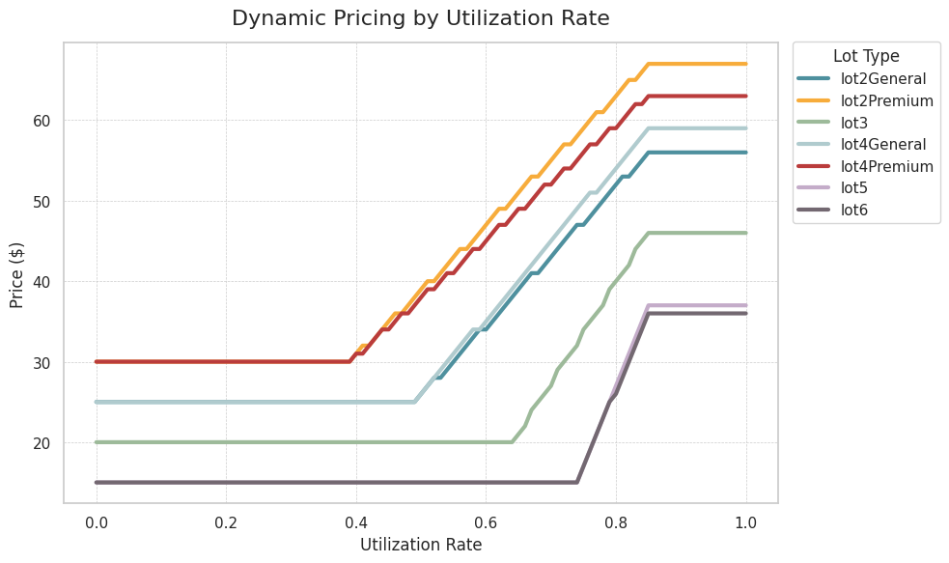
Dynamic Pricing Ruleset
LOTS | Lowest Threshold | Lowest Price | Highest Threshold | Highest Price
Lot 2 & 4 General | 50% | $25 | 85% | Lot 2: $56 Lot 4: $59
Lot 2 & 4 Premium | 40% | $30 | 85% | Lot 2: $67 Lot 4: $63
Lot 3 | 65% | $20 | 85% | $46
Lot 5 & 6 | 75% | $15 | 85% | Lot 5: $37 Lot 6: $36
Maximum price is found through formulas that takes into account each lot’s elasticity,
average utilization, and occupancy sensitivity
Notes:
Each lot has a lower threshold and an upper threshold of utilization rate. After passing the lower threshold, the price will increase until it reaches the upper threshold.
The max prices that is set at the upper threshold was calculated through a mathematical formula that took into account each specific lot’s elasticity, average utilization, and occupancy sensitivity.
The minimum prices that are set at the lower threshold is just $5 off of the current prices. This is done to incentivize parking at emptier lots.

Slide 19
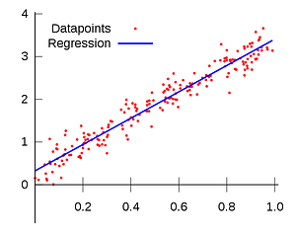
Simulating with Machine Learning
Linear Regression Model
A way to understand how a factor we change or measure (like lot occupancy) affects an outcome we care about (like revenue). The model finds the line that best fits the data points so we can make predictions or see trends.
In simple terms, it’s like drawing the best-fit line through a scatter of points to predict what happen next

Slide 20
Historical Parking Data
Date | Lot % utilized
1/1/2020| 0.331231
1/2/2020| 0.411242
1/3/2020| 0.408727
…
Historical Revenue Data
Date | Revenue
Jan/2020| 339101
Feb/2020| 399189
Mar/2020| 406758
…
^{Linear Regression Model}
Base Pricing Table
Utilization | Price
0.4 | $20
0.41 | $20
0.42 | $20
…
Dynamic Pricing Table
Utilization | Price
0.4 | $15
0.41 | $17
0.42 | $18
…
Year
2025
2026
2026
2026
Month
12
1
2
3
Total Revenue
$100,000
$250,000
$150,000
$300,000
How Our Model Works
Notes:
Used to Create Occupancy & Revenue Data

Slide 21
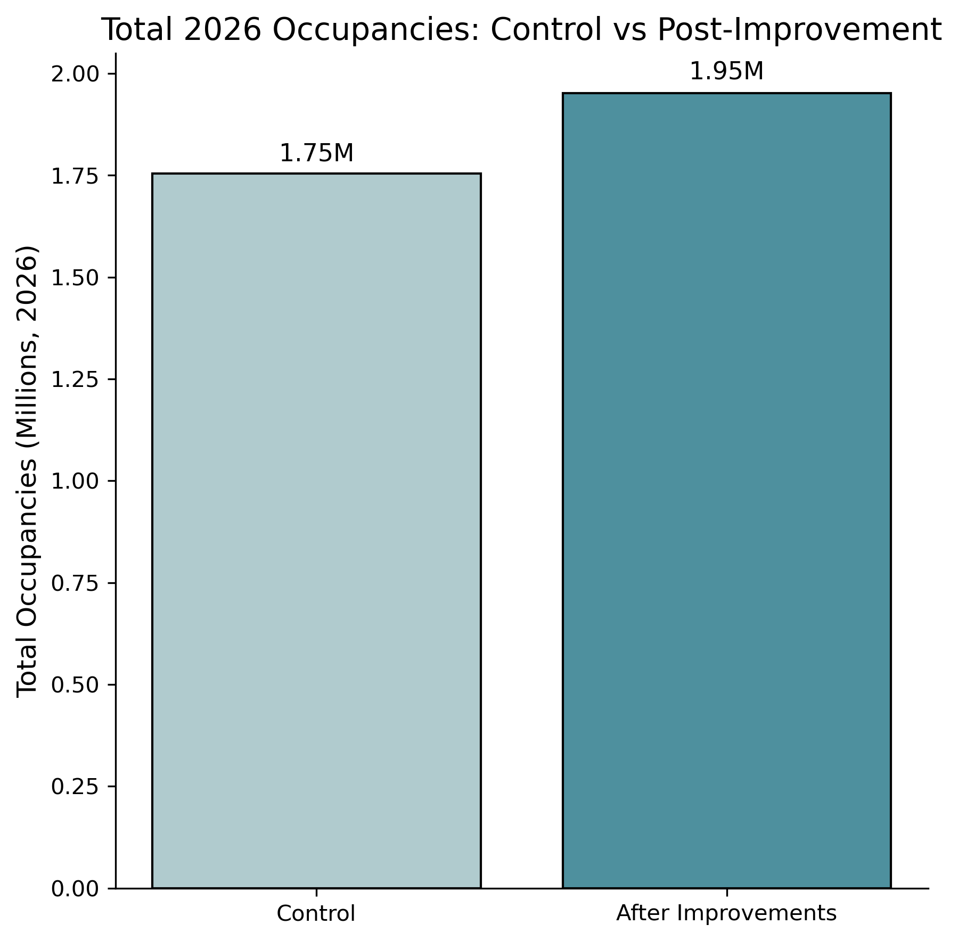
2 Occupancy Datasets
Control Set
Projects 2026 parking occupancy using historical patterns and Linear Regression without any operational or pricing adjustments.
Uses base pricing ruleset to predict revenue
Improved Set
Based on the Control set but increases average occupancy rate by 2% per month of control (expected due to other solutions)
Reduces disparities between high- and low-utilization lots by redistributing demand
Uses dynamic pricing ruleset to predict revenue
Improved dataset expects about 200,000 more occupancies in 2026
Control vs. Improved

Slide 22
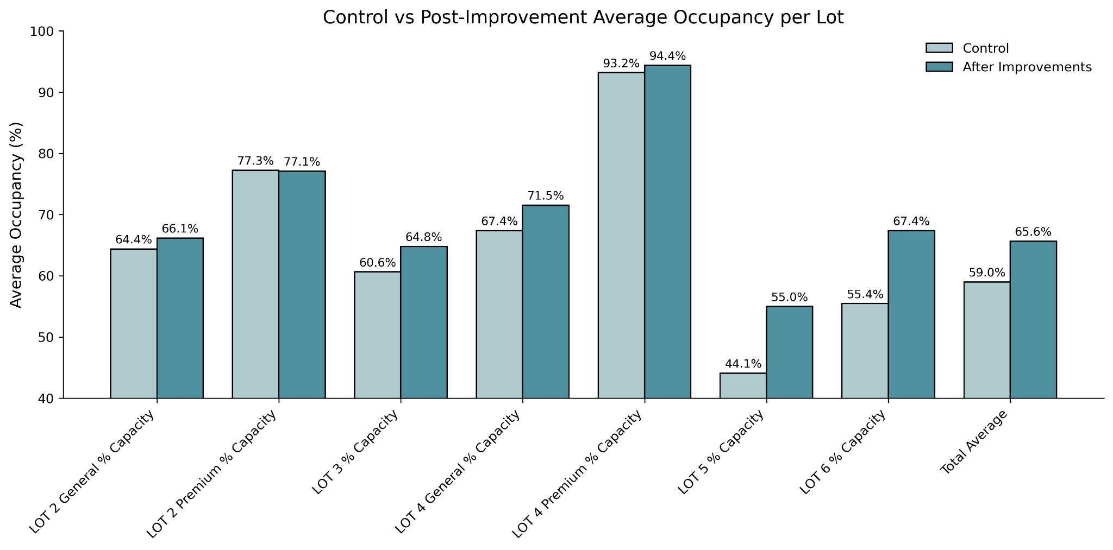
2 Occupancy Scenarios
Because of the supplemental solutions and a dynamic pricing model, we can expect overall increase as well as more even distribution
Improved model increases average occupancy by 6.6% and raises participation in Lots 5 and 6 without sacrificing participation in other lots

Slide 23
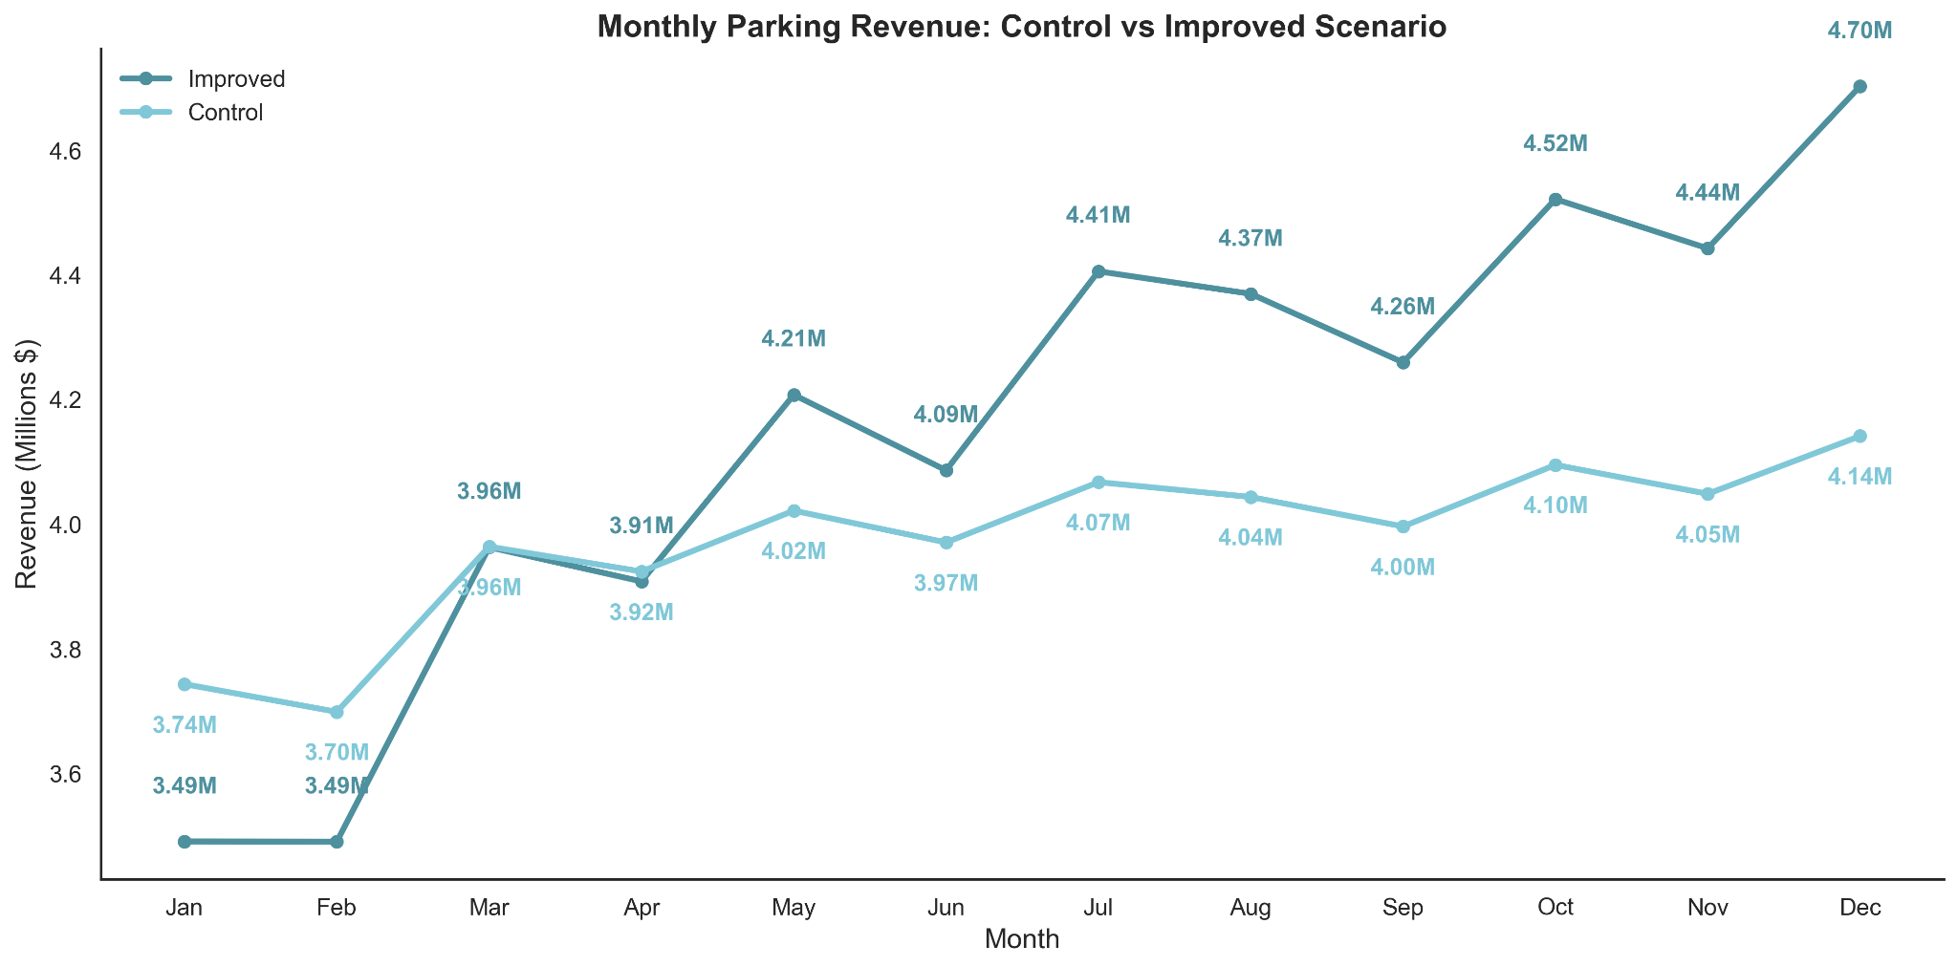

Results of Dynamic Pricing
Control: Base pricing
Improved: Slow increase, smoothing, and Dynamic pricing
Control
$47.72M
Improved
$49.85M
4.47%
Increase in revenue
Notes:
Comparing Control Group and Ideal Scenario
Revenue:
Control: 47.72 million USD
Improved: 49.85 million USD
4.47 % increase in revenue, while still enhancing customer experience

Slide 24
Modernization
Solutions

Slide 25
Lot Signage Mockup
Offer Real-time Parking
Availability Information
Lot 6 Parking
Parking Spaces Available
Real-time visibility helps drivers find open spaces faster, reduces traffic buildup, and improves lot utilization efficiency
17

Slide 26
Lot 2 General
Lot 2 Premium
Lot 3
Website Example
303 spots available
50 spots available
502 spots available
Directly in front of terminal 2. Rates start from to $25/day.
A shorter walk to Terminal 2. Rates start at $30/day.
In between terminal 2 and 4. A short walk from both. Rate start at $20/day.
Real-time visual indicator helps visitors quickly identify lots with spaces, reduces congestion, and promotes smarter parking decision.
Occupancy:
Occupancy:
Occupancy:
60%
75%
40%
*EV charging station available
*EV charging station available
*EV charging station available
Pre-Book Parking
Pre-Book Parking
Pre-Book Parking
Estimate Costs 🠞
Estimate Costs 🠞
Estimate Costs 🠞

Slide 27
Expand EV Charger Infrastructure
Short-Term
+8
16 total
Lot 2, 4
Quick expansion using existing infrastructure
Long-Term
+20
~36 total
Lot 5, 6
Infrastructure build-out & scalable growth

Slide 28
Customer Experience
Solutions

Slide 29
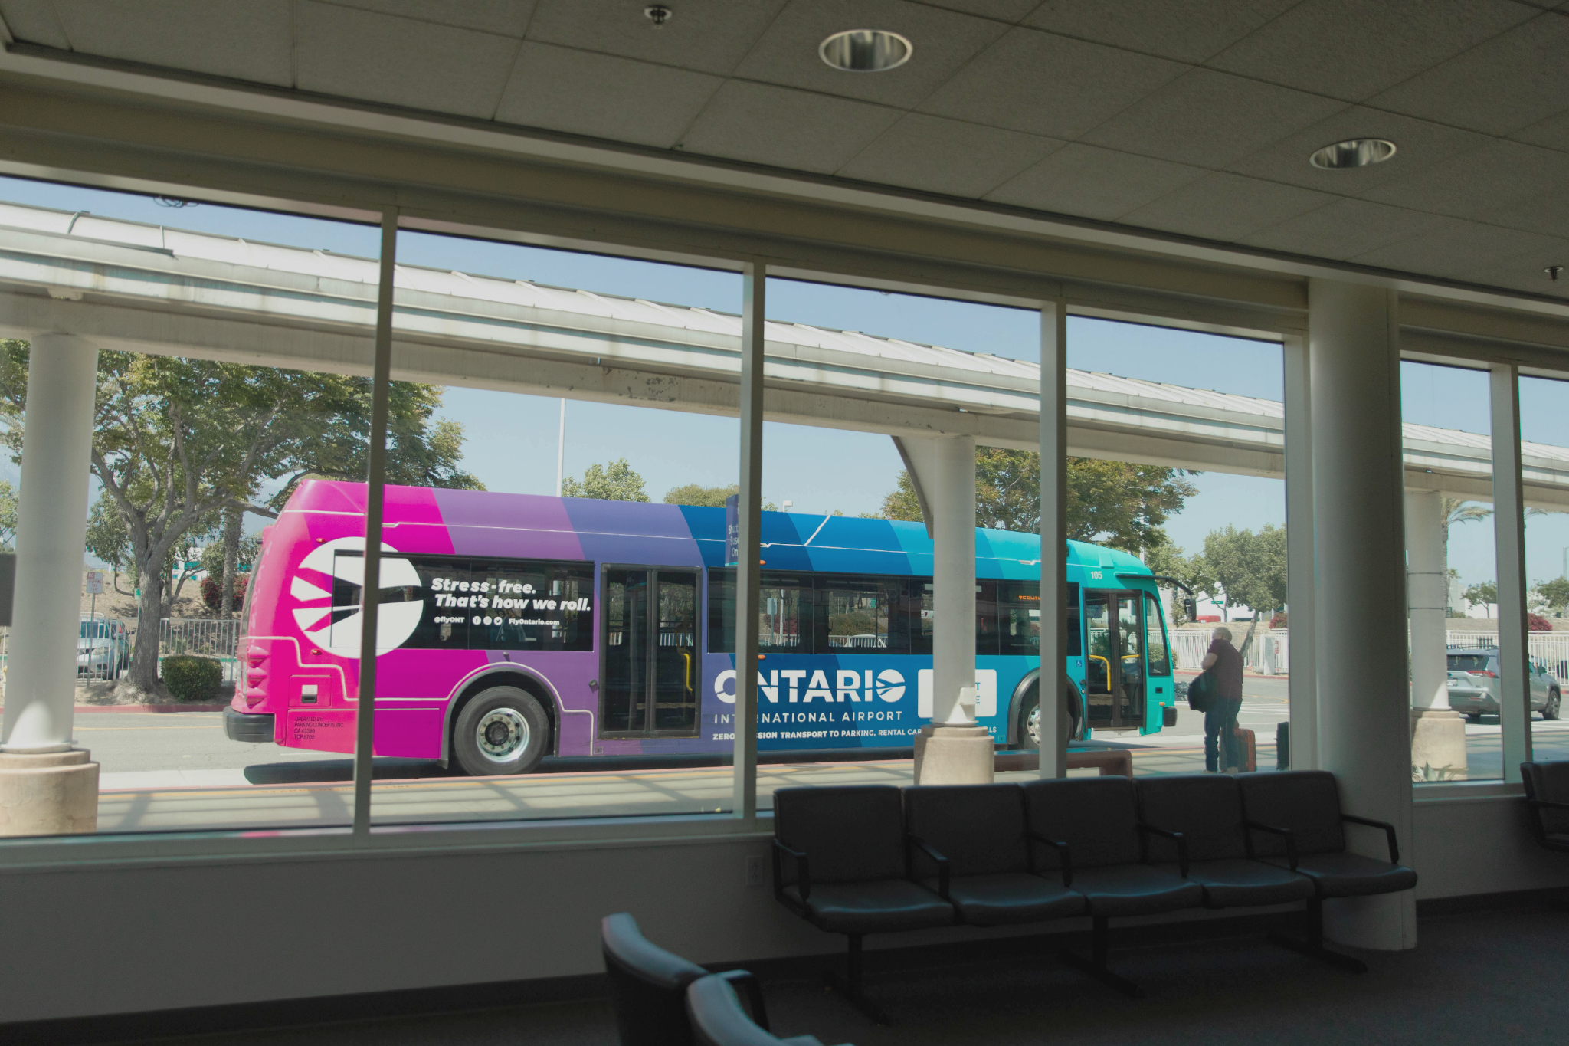
Increase Shuttle Frequency
Reduce shuttle intervals from every 20 minutes to every 10 minutes to encourage passengers to use Lots 5 and 6

Slide 30




Real-Time Shuttle Location Map
QR Codes placed at shuttle stops, linking directly to the map
Live tracking for shuttle arrivals, departures, and wait times

Slide 31
New
Location
Relocate TNC pick-up and drop-off areas
Terminal
Moving the TNC drop-off/pick up significantly reduces congestion
near terminal entrances

Slide 32
04
Implementation

Slide 33
Implementation Timeline
Year 2
Year 3
Year 4
Year 5
Pilot dynamic pricing
Full Integration with TIBA System
Utilization
Model Learning with New Data
Lot signage
Long-Term Success Metrics
Modernization
EV Charging Rollout
EV Charging Expansion
Performance Reviews
Customer experience
Cross-Train Employees
Feedback
Increase Shuttle Fleet

Slide 34
References
Feeney, B. P. (1989). A review of the impact of parking policy measures on travel demand. Transportation Planning and Technology, 13(4), 229–244. https://doi.org/10.1080/03081068908717403
Parking Concepts, Inc. (n.d.). Parking Concepts Inc. Retrieved October 22, 2025, from https://parkingconcepts.com/
Generative AI was used in this presentation.

Slide 35
Thank you

